Slide 1
Data Centralizing
By: Muhammad Afif Hendrawan, S.Kom., M.T.
Translated by: Septian Enggar Sukmana

Slide 2
Outlines
Definition
Measurement of Data Centralizing

Slide 3



What is data centralizing?
A statistic summary of data

Slide 4
Data Centralizing
Definition
A single value which describes a central of a group of data
A technique to look for median at a group of data
A statistic summary from a group of data
Can be measured by mean, median, and mode

Slide 5
Measurement of Data Centralizing
How to measure mean, median, and mode?

Slide 6
Measurement of Data Centralizing 📐
Data Centralizing
Mean
Median
Mode
Average
Middle Value
The most frequent value

Slide 7


Mean → Average
Mean
Mean can be obtained by summing all value at the group of data, then divided by total data at the group of data
General Form
Simple Form
$$\overline{x}=\frac{x_{1}+x_{2}+x_{3}+…+x_{n}}{n}$$
$$\overline{x}=\frac{\sum{x}}{n}$$

Slide 8


Mean → Sample vs. Population
Sample
Population
$$\overline{x}=\frac{\sum{x}}{n}$$
$$μ=\frac{\sum{x}}{n}$$
X bar
mu

Slide 9
Mean → Case Study (1)
Case
There is a basket which contains 10 apples with the following weight for each apple:
100gr, 200gr, 150gr, 100gr, 120gr, 80gr, 90gr, 160gr, 110gr, 170gr
Mean
$$μ=\frac{100+200+150+100+120+80+90+160+110+170}{10}=\frac{1280}{10}=128$$

Slide 10
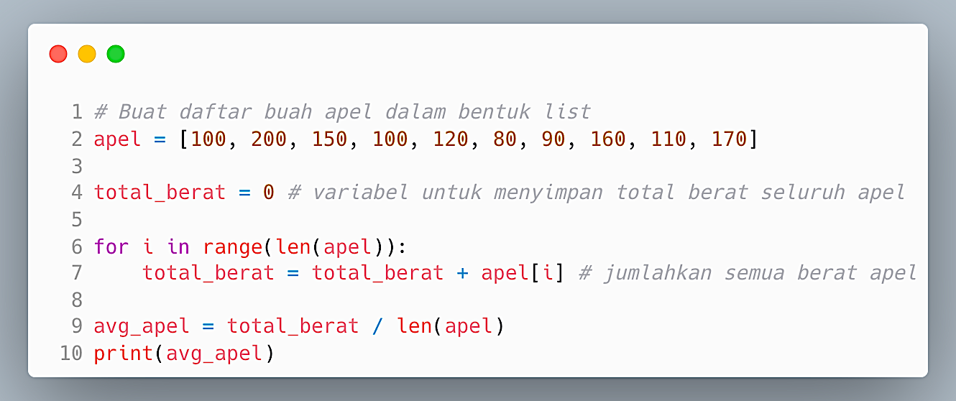
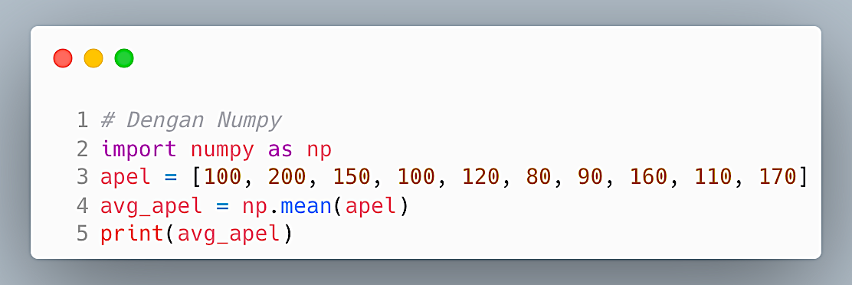
Mean → Study Case (2)
Native
Using Numpy

Slide 11
Median
Definition
A value which lays on the middle of data group which has been sorted ascendantly
Example
20gr, 30gr, 100gr, 50gr, 40gr → 20gr 30gr, 40gr, 50gr, 100gr
20gr 30gr, 40gr, 50gr, 100gr

Slide 12

Median → Jumlah Data Ganjil vs. Genap
Ganjil
20gr, 30gr, 100gr, 50gr, 40gr → 20gr 30gr, 40gr, 50gr, 100gr
20gr 30gr, 40gr, 50gr, 100gr
Genap
20gr 30gr, 40gr, 45gr, 50gr, 100gr
$$median=\frac{40+45}{2}=47.5$$

Slide 13
Median → Example
Native
Using Numpy

Slide 14
Modus → The Most Frequent Value
Mode
Mode is the values which most appear frequently at the group of data
Example
12th High School Student Grade at SMA XYZ → 70, 80, 70, 70, 90, 100
70 → 3 times; 80 → 1 time; 90 → 1 time; 100 → 1 time
Mode = 70

Slide 15
Mode → Example
Scipy vs. Native

Slide 16
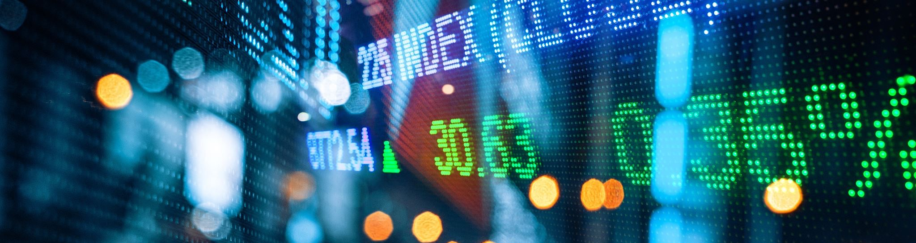
Advantage of Data Centralizing
What is the advantage of data central finding?

Slide 17
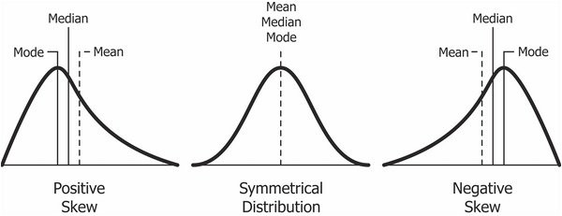
Skewness

Slide 18
Data Distribution
By: Muhammad Afif Hendrawan, S.Kom., M.T.
Translated by: Septian Enggar S

Slide 19
Outlines
Definition
Measurement
Shifting and Scaling

Slide 20
What is data distribution?
The definition? And what for?

Slide 21
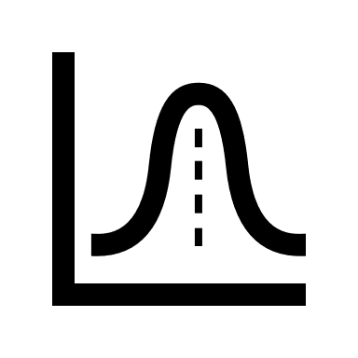
Data Distribution
Definition
A value which describes the distance between data to central data
Used to measure how optimum the value of data centralizing
To find data central value which most relevant to the data condition

Slide 22

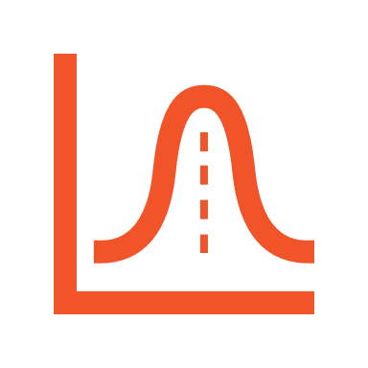
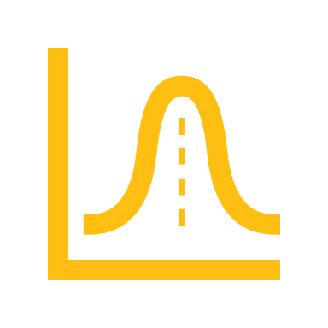
Measurement of Data Distribution #1
Measurement of data distribution can be performed by finding its range and interquartile range (IQR). But, what are they?

Slide 23

Range
Range Value
A difference value between the highest observed value to the smallest one
Used to show the standout of extreme value
The value is influenced by its extreme value (the highest or the smallest one)
Formula
$$range=x_{max}−x_{min}$$

Slide 24

Range – Example
12th math student grade at SMA XYZ
23 56 45 65 59 55 62 54 85 25
Python
Result
$$rentang=85−23=62$$

Slide 25

Interquartile Range (IQR)
Kuartil (Quartile)
Dividing data into 4 groups, the 25% first part(Q1), 50% data (Q2), 75% data (Q3), and 100% data (Q4) respectively
IQR Value
Mathematical Definition
A value which is used to describe 50% middle observed value
$$IQR=Q3 −Q1$$

Slide 26
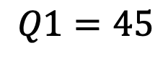
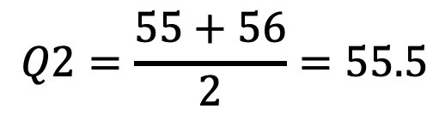
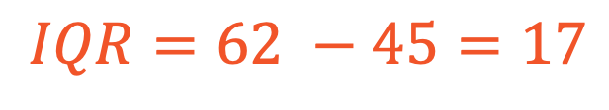
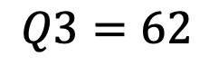
How to obtain Q3 and Q1 value? (1)
1st Example
23 25 45 54 55 56 59 62 65 85
Q2
Q1
Q3
$$Q2=\frac{55+56}{2}=55.5$$
$$Q1=45$$
$$Q3=62$$
$$IQR=62 −45=17$$

Slide 27
How to obtain Q3 and Q1 value? (3)
2nd Example
23 25 45 54 55 55 56 59 62 65 85
Q1
Q2
Q3

Slide 28
How to obtain Q3 and Q1 value? (3)
Python

Slide 29
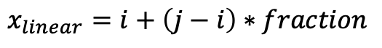
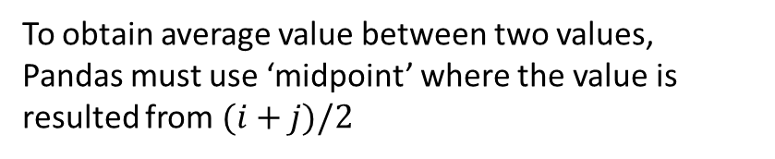
Why the result from Python Pandas is different?
In Pandas, the approach of finding percentile dan quantile (including quartile) value is performed by using LINEAR INTERPOLATION value
Linear interpolation value is utilized when the looked value is located between two values (total data is even)
Linear interpolation value can be obtained by
Perhatikan nilai Q1, Q2, dan Q3
$$x_{linear}=i+\left(j−i\right)∗fraction$$
To obtain average value between two values, Pandas must use ‘midpoint’ where the value is resulted from $(i+j)/2$

Slide 30
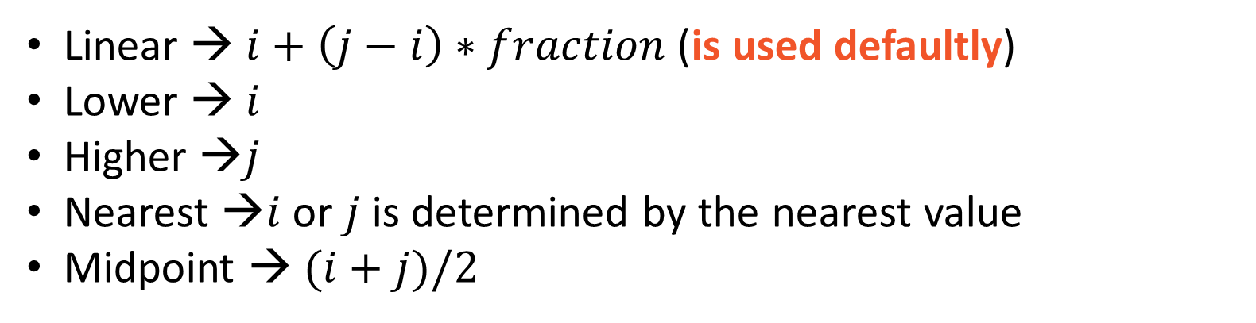
Finding percentile, quantile, or quartile value using Python libraries
Example
Linear → $i+\left(j−i\right)∗fraction$ (is used defaultly)
Lower → $i$
Higher →$j$
Nearest →$i$ or $j$ is determined by the nearest value
Midpoint → $(i+j)/2$

Slide 31
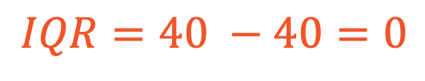
Anomaly in IQR
Example
30 40 40 40 40 40 40 40 40 40 90
Q1
Q2
Q3
???
The IQR is 0 shows that observed value is identical
$$IQR=40 −40=0$$

Slide 32


Variance
Definition
The value that describes how far the data is distributed from mean
Population
Sample
$$σ^{2}=\frac{\sum_{i=1}^{N}{{\left(x_{i}−μ\right)}^{2}}}{N}$$
$$S^{2}=\frac{\sum_{i=1}^{n}{{\left(x_{i}−\overline{x}\right)}^{2}}}{n−1}$$

Slide 33


Standard Deviation (1)
Definition
The value which describes how high the data variation is distributed to mean
Population
Sample
$$σ=\sqrt{\frac{\sum_{i=1}^{N}{{\left(x_{i}−μ\right)}^{2}}}{N}}$$
$$S=\sqrt{\frac{\sum_{i=1}^{n}{{\left(x_{i}−\overline{x}\right)}^{2}}}{n−1}}$$

Slide 34
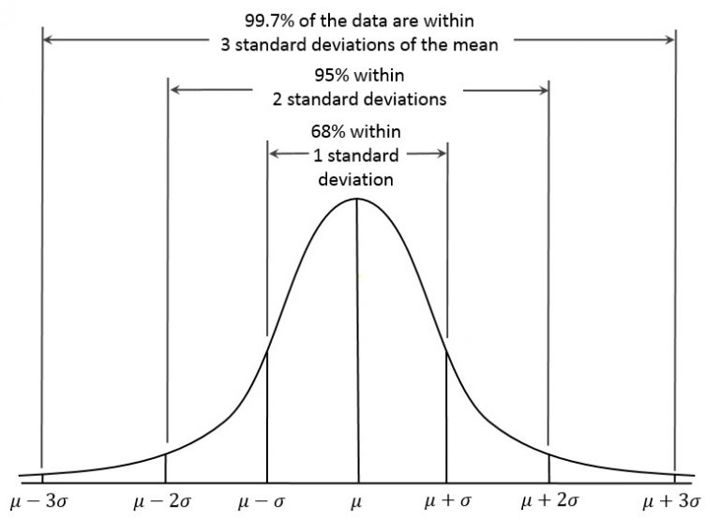
Standard Deviation (2)
https://s4be.cochrane.org/blog/2018/09/26/a-beginners-guide-to-standard-deviation-and-standard-error/#:~:text=Standard%20deviation%20tells%20you%20how,standard%20deviations%20of%20the%20mean.

Slide 35
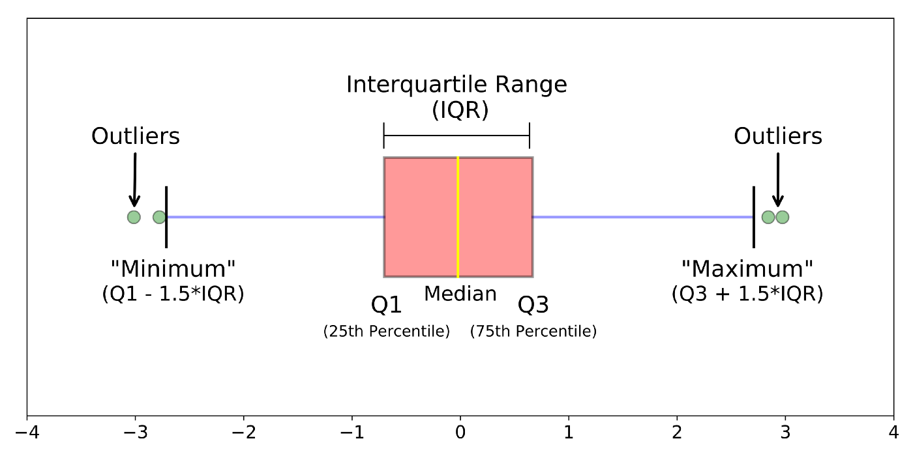
Box Plot
Sumber: https://towardsdatascience.com/understanding-boxplots-5e2df7bcbd51#:~:text=A%20boxplot%20is%20a%20standardized,and%20what%20their%20values%20are.

Slide 36
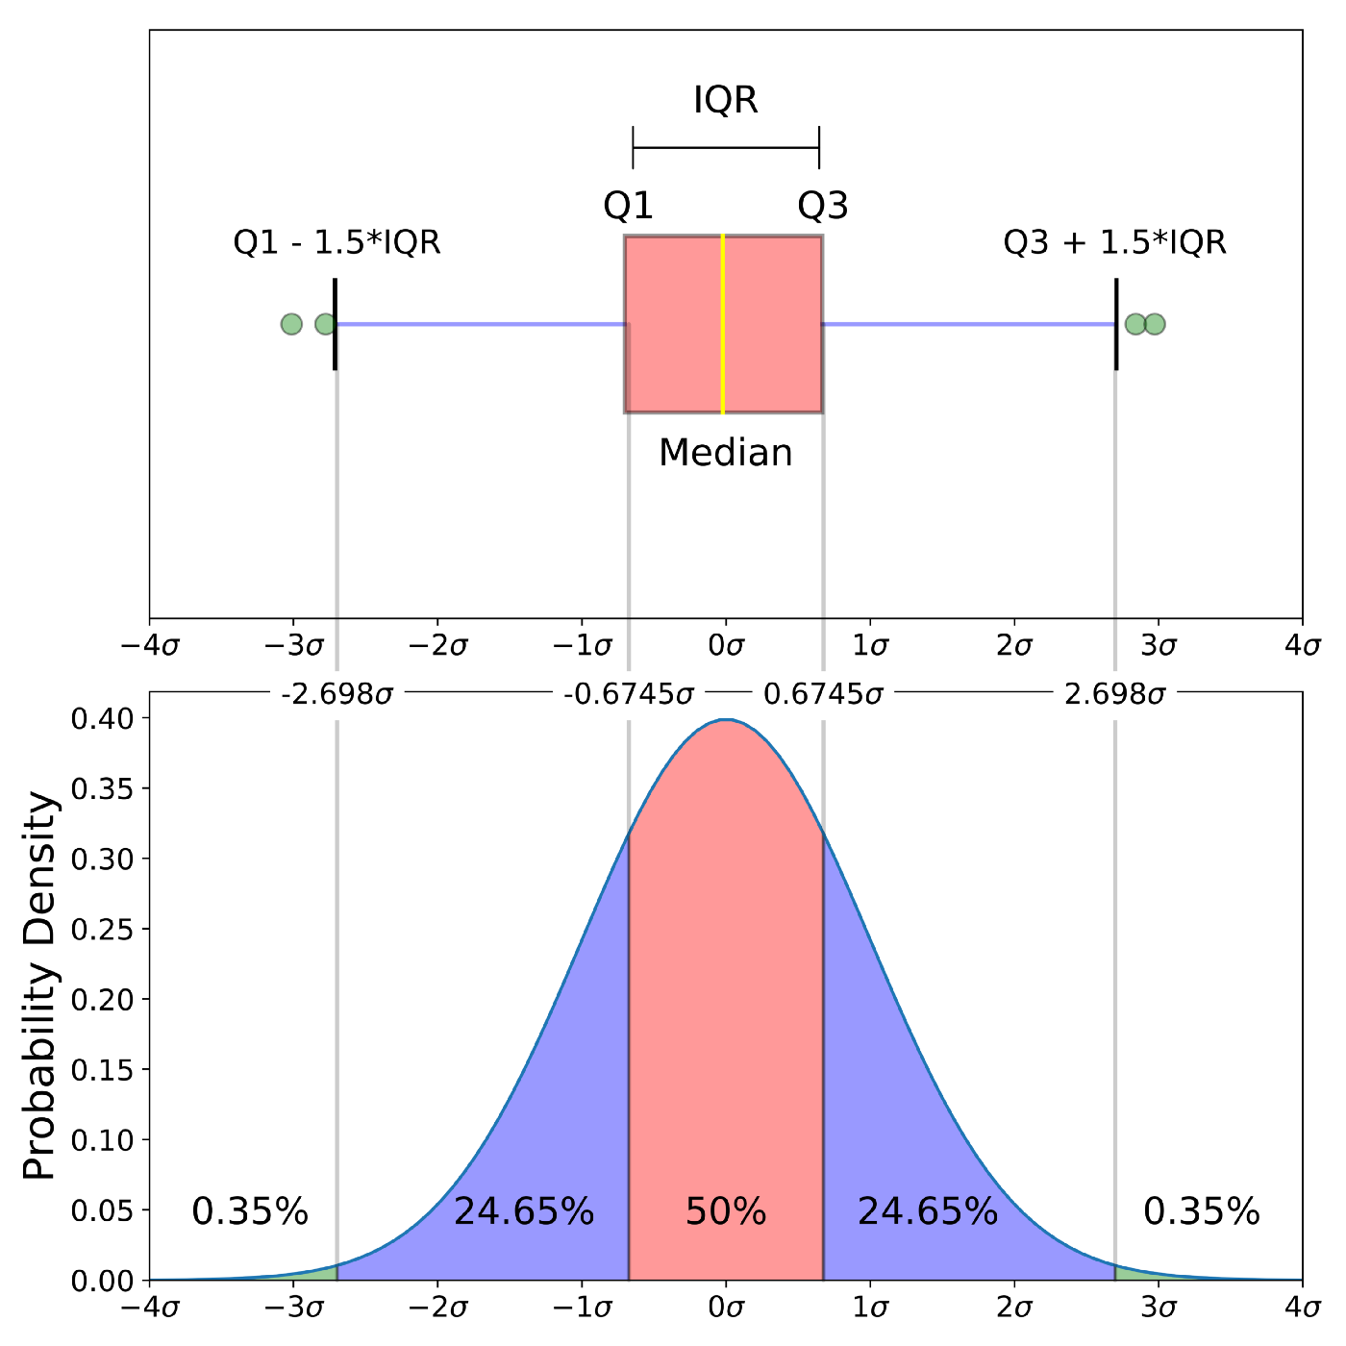
Box Plot In Normal Distribution
Outliers
Sumber: https://towardsdatascience.com/understanding-boxplots-5e2df7bcbd51#:~:text=A%20boxplot%20is%20a%20standardized,and%20what%20their%20values%20are.

Slide 37
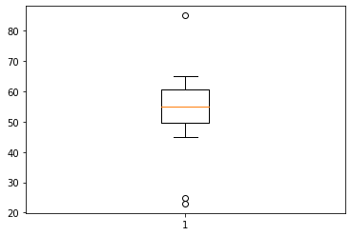
Box Plot: Example
Outliers
23 25 45 54 55 55 56 59 62 65 85

Slide 38
Shifting and Scaling
How the data change affects data distribution and centralizing

Slide 39
Shifting
Definition
Value Shifting at the group of data can be performed by adding (+) or subtracting (-) all values at the group using certain value
Example 1
Example 2
4, 5, 8, 12 → +2 → 6, 7, 10, 14
4, 5, 8, 12 → -2 → 2, 3, 6, 10

Slide 40
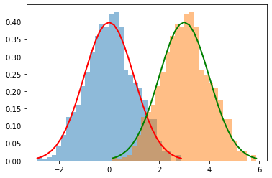
The Effect of Shifting (1)
Ground Truth
Shifted Data
4, 5, 8, 8, 12
Mean = 7.4
Median = 8
Mode = 8
Range = 8
IQR = 3
STD = 2.8
+2 → 6, 7, 10, 10, 14
Mean = 9.4
Median = 10
Mode = 10
Range = 8
IQR = 3
STD = 2.8

Slide 41
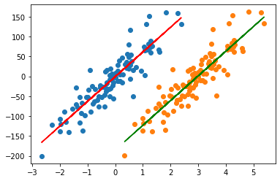
The Effect of Shifting (2) – Prior Shift in ML

Slide 42
Scaling
Definition
Value scaling is performed by multiplying or dividing all values at the group of data using certain value
Example 1
Example 2
4, 5, 8, 12 → ×2 → 8, 10, 16, 24
4, 5, 8, 12 → ÷2 → 2, 2.5, 4, 6

Slide 43
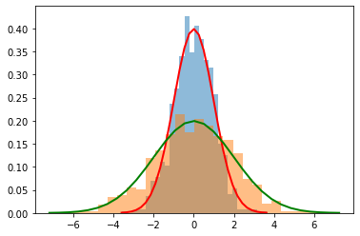
The Effect of Scaling
Ground Truth
Data Scale
4, 5, 8, 8, 12
Mean = 7.4
Median = 8
Mode = 8
Range = 8
IQR = 3
STD = 2.8
×2 → 8, 10, 16, 16, 24
Mean = 14.8
Median = 16
Mode = 16
Range = 16
IQR = 6
STD = 5.6

Slide 44
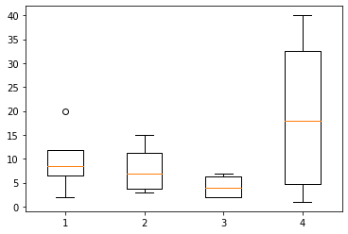
The Advantage of Scaling – Data Normalization (1)
Is read by column using matplotlib

Slide 45
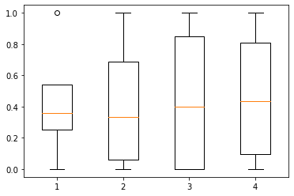
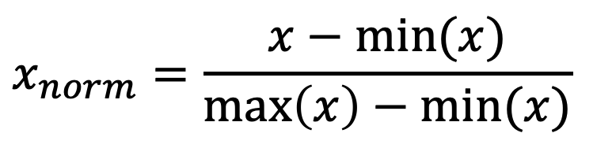
The Advantage of Scaling – Data Normalization(2)
$$x_{norm}=\frac{x−min⁡(x)}{\max\left(x\right)−min⁡(x)}$$

Slide 46
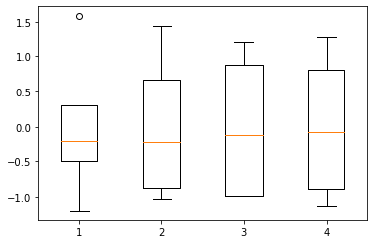
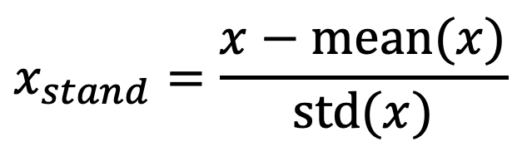
The Advantage of Scaling – Data Standardization
$$x_{stand}=\frac{x−mean⁡(x)}{std(x)}$$

Slide 47


